Slide 1
Group 3 Banking Project
Terilyn Truong, Matthew Knight, Jorge Olan Santos, Michael Conant, Louie Vargas

Slide 2
Important Requirements
There should be a banking system as well as an ATM system.
Bank employees and customers must be able to log in with their account ID and password.
Bank customers should be able to perform basic bank functions (i.e deposit, withdraw, and transfers).
Bank employees should be able to create accounts and delete accounts.
A GUI should be provided so that actions can be performed.
Notes:
Louie

Slide 3
Special Challenges
First time implementing we tried to use Vectors, but we ended up moving to ArrayList because it was more practical and easier to implement
We wanted to create two clients, a bank teller client and a ATM client. We were getting difficulties having both clients communicate with the server.
We did not have enough time to fully integrate the GUI
Hard to understand how classes work without visual aid
The UML diagrams required multiple revisions
Communicating ideas can be difficult
Had to implement a new class topic soon after learning about it
Essential keywords were forgotten at times (public, package)
Notes:
Terilyn - UML diagrams/Communicating ideas
Jorge - Hard to understand how classes work/not have time to implement GUI/had to implement new class topic/Essential keywords
Louie - Vectors/ two clients

Slide 4
Hindsight Lessons
Working with GUI elements is more complicated than anticipated
Expect UML diagrams to change as the project progresses
Take care to ensure the proper keywords/package are included in the code
Start working on the project sooner
Notes:
Jorge - Expect UML diagrams to change, proper keywords/package

Slide 5
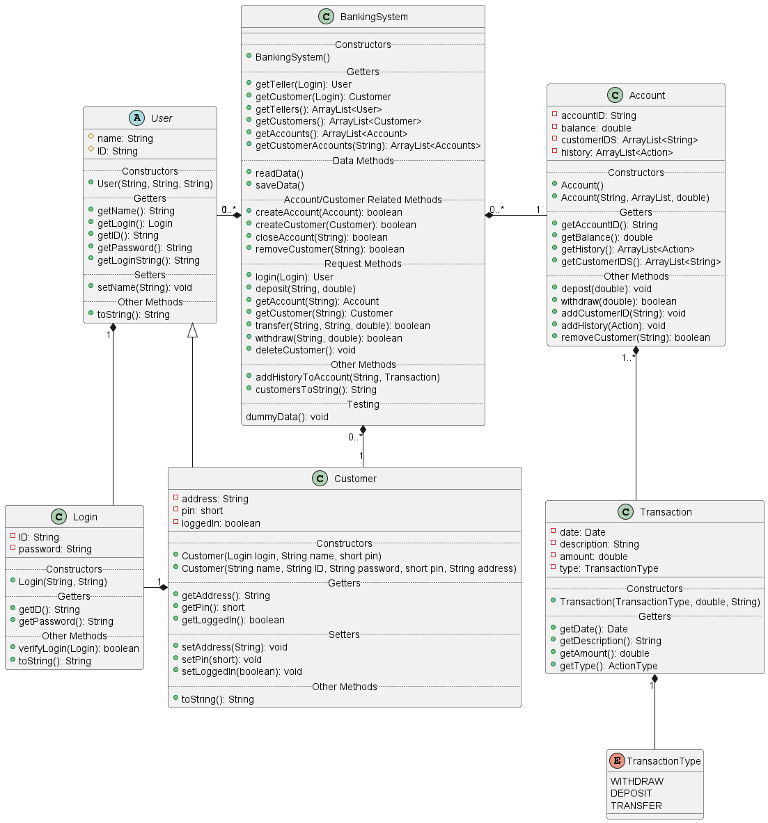
Class UML diagram
BankingSystem is the main class that handles received Requests by the client.
Account is the actual bank account that holds the balance and the Customer IDS that have access to the account.
Because of this Accounts are not tied to one specific customer.
Customers can also have access to multiple accounts.
Notes:
Michael

Slide 6
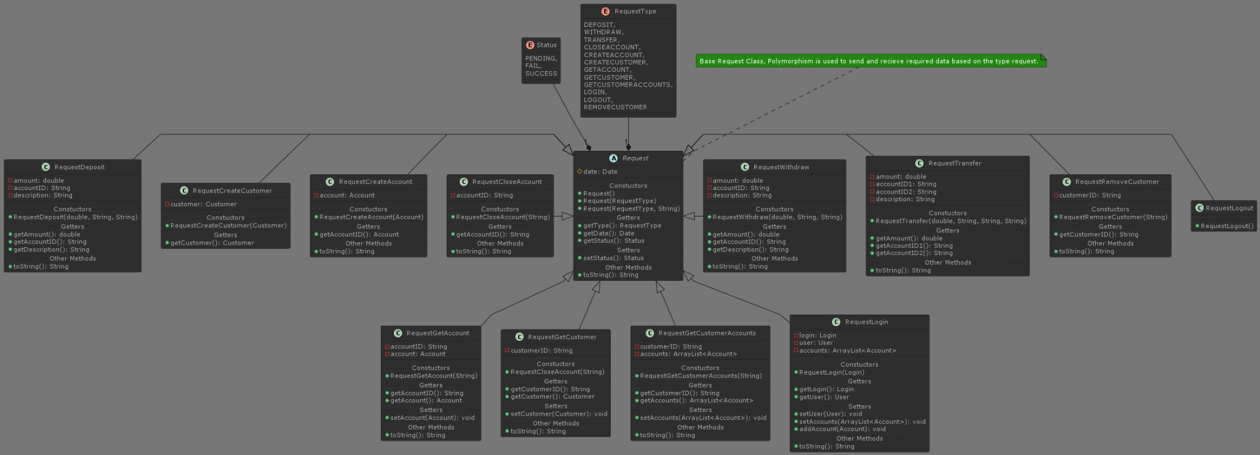
Request Class UML diagram
Notes:
Michael

Slide 7
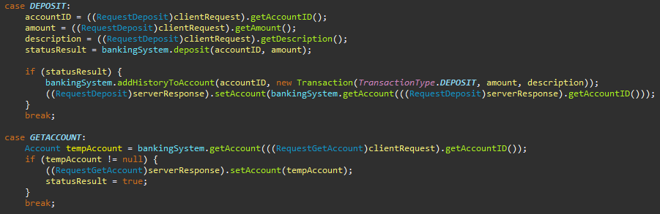
Request Class
Request is the base class that we use to send and receive messages between the client and server.
Other requests types have their own class that extend Request
On the server end we then use polymorphism to handle the request.
The server receives general request and with a switch statement we handle each type.
This allows us to have specialized date and methods for each request type.
Notes:
Michael

Slide 8
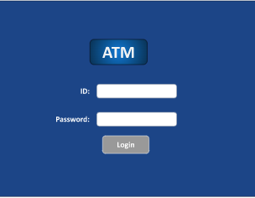
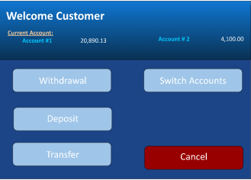
GUI
Notes:
Matthew

Slide 9
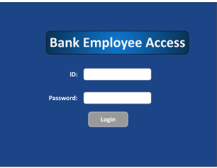
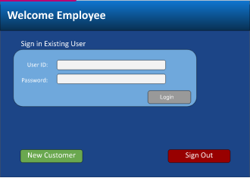
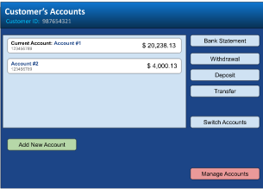
GUI
Notes:
Matthew

Slide 10
Demo
Notes:
Michael

